Slide 1
Introduction to microcables

Slide 2
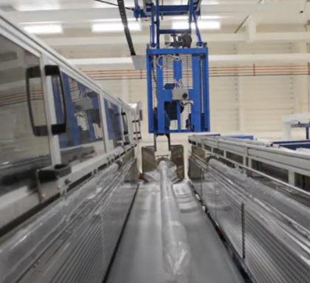
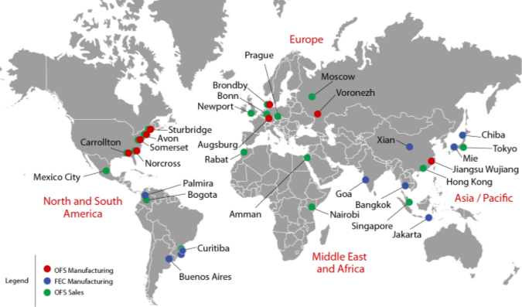
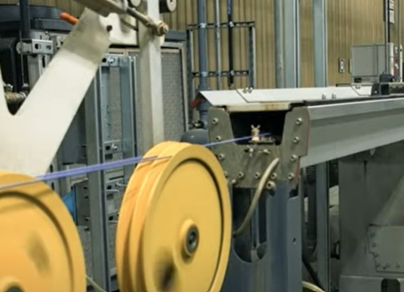
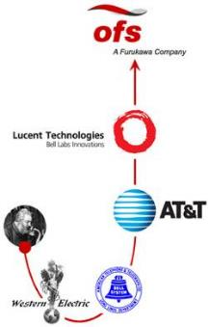
OFS – Stable, Reliable, Customer Focused Worldwide Resources
Mark Boxer OFS

Slide 3
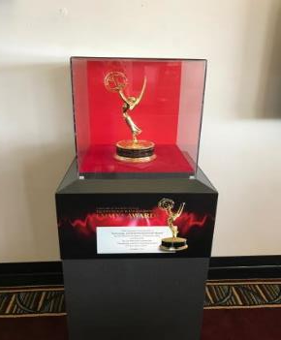
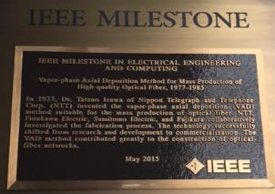
An Original Inventor of Fiber
40+ year history in fiber technology
Technology Emmy Award winner, 2017
“Pioneering Invention and Deployment of Fiber Optic Cable”
Fiber manufacturing method, IEEE Milestone Recipient
<250 granted in the history of electricity
Others include AC power, Maxwell’s equations, telephone, television, etc.
Hundreds of patents including the LC connector

Slide 4
How we’ve changed the world

Slide 5
Industry Stewards
OFS takes seriously its leadership role as a steward for industry change, viability, and innovation.
Our professional memberships show the breadth of this commitment:

Slide 6
Bend loss vs wavelength and radius
Optical Fiber Bending Loss Increase vs Wavelength
Macro-bending Loss of typical standard G.652D SMF
Single 360 degree turn (maximum loss)
20
15
10 mm radius
std SMF
Macrobending Loss (dB)
7.5 mm radius
10
std SMF
5
5 mm radius
std SMF
0
1260
1280
1300
1320
1340
1360
1380
1400
1420
1440
1460
1480
1500
1520
1540
1560
1580
1600
1620
Wavelength (nm)
Bending loss of Std SMF (G.652D) can disrupt services or reduce reach

Slide 7
Bending Loss will become an even Bigger Challenge Increasing 2 to 4 times from Current Systems
Application | Standard | Current Generation |  | Next Generation on Same Fiber Network |  | Bending Loss Increase
FTTH | IEEE | GE-PON downstream | 1490 nm | 10G E-PON downstream | 1577 nm | 3X
 | ITU-T | G-PON Downstream |  | 10G-PON downstream
 |  |  |  | 40G-PON (NG-PON2) | 1603 nm | 4X
DOCSIS and HFC | SCTE /ITU | RF-Video downstream | 1550 nm | RFoG upstream | 1610 nm | 2X
Metro and some Long Haul | ITU | C-Band DWDM /CWDM | 1560 nm | L-Band DWDM /CWDM | 1625 nm | 2.5X

Slide 8
AllWave®+ and AllWave One Fibers The next generations of single mode fiber
15% lower loss for up to 15% longer reach
Even lower bend loss
(30% lower than AllWave + fiber)
G.657.A1bend loss
33% better PMD LDV (0.04)
10 mm min bend radius
Full Spectrum
Zero Water Peak
9.2 MFD for seamless splicing and testing
100% Synthetic Silica
Pure Reliable Glass
16 mm min bend radius
13% -33% lower loss than G.652.D
G.652.D

Slide 9
OFS AllWave®+ Fiber advantages vs. others
Parameter | Desired
Optical Spectrum | 100% ZWP, 5 wavelengths specified loss In-cable | ✓
Bending Performance | AllWave+ Fiber G.657A1 bend insensitive 9.2 micron MFD | ✓
PMD | Extensive in-cable performance and specification | ✓
Glass Material | 100% pure synthetic silica core and cladding | ✓
Mechanical Reliability | Dynamic fatigue performance. Excellent coating reliability | ✓

Slide 10
Microcables

Slide 11
Do you know where all of your customers are?
Do you know where your customers will be?

Slide 12
Microcables and microducts
Applications
Override - installed in existing ducts with existing cables
Installed in previously unused innerducts
Greenfield, “grow as you go” applications
Benefits
Materials
High fiber density - 200% better space efficiency
Labor
Blown cable enables faster deployment than pulled cable
Longer blowing distances, fewer splice points
Smaller, easier to handle, equipment needed for install
Financial/Intangible
Flexibility to grow network as needed

Slide 13
Why do we need more pathways?
New customers
Space for competitors
Unexpected growth
Picture courtesy of Dura-Line

Slide 14
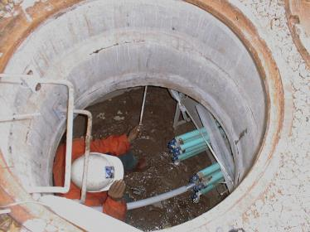
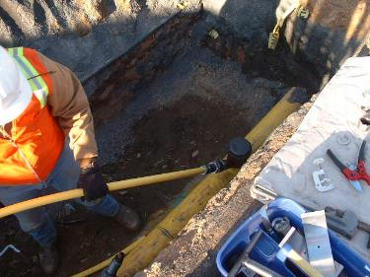
Microcables / Microduct Applications
Ducts
Empty or part-filled ducts are valuable
Space is at a premium, limited and expensive
Civil works are expensive, time consuming and disruptive
Difficulties in obtaining permits
Microcables and ducts maximize existing duct infrastructure
Add fiber as required – defer the cost
Gives upgrading ability
Notes:
The current situation in built-up areas – cities & towns.

Slide 15
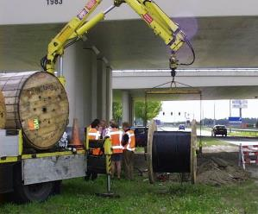
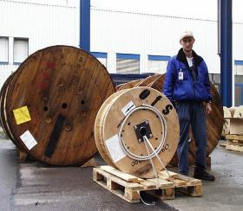
Additional advantages of microcables
Standard cable reels requires large cable drums and special transport
(weight = several hundred kg)
Microcable sizes and transport costs are much lower
MiDia FX 72f 2 km cable reel

Slide 16
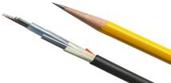
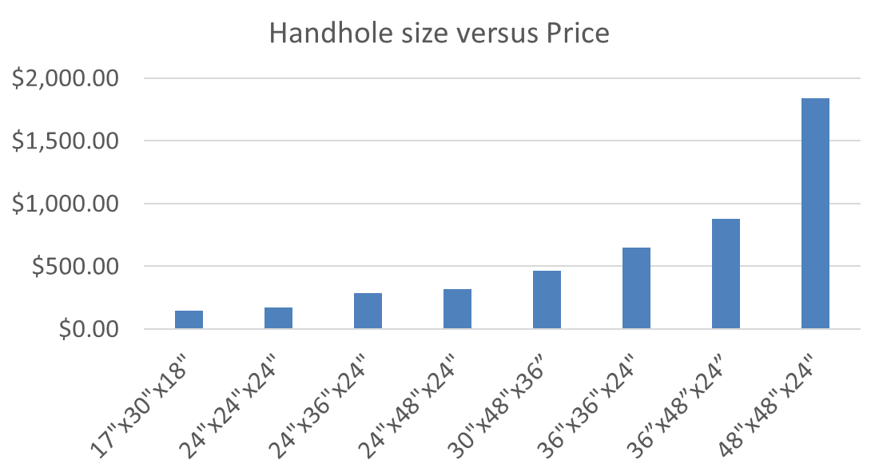
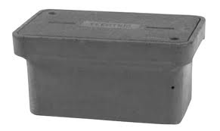
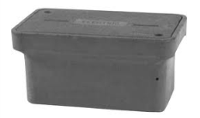
Compact Cabling Can Reduce Total Installed Costs

Slide 17
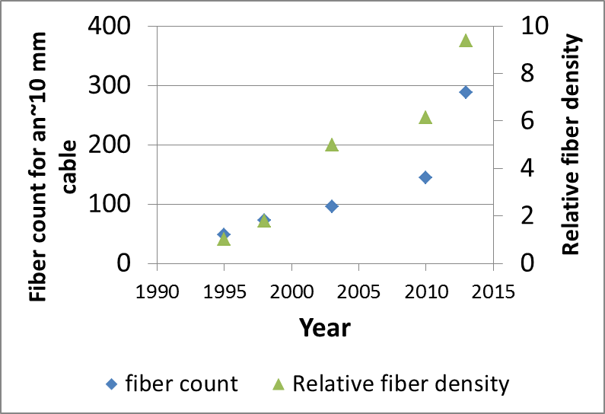
Evolution of optical cable
Next Generation microcable
Microcable
Traditional
Notes:
Move to 200 micron section

Slide 18
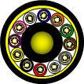
OFS Loose Tube microcable lineup
144 fiber cable example
MiDia® FX, 1.7mm PBT gel-filled tubes
GR-20 Issue3 Compliant, 300# tensile rating
MiDia® GX, 1.5mm PBT gel-filled tubes*
NOT GR-20 Compliant
Higher fiber counts require AW FLEX
MiDia®2 FX/GX, 1.7mm PBT gel-filled tubes*
NOT GR-20 Compliant
Uses 200um AllWave® FLEX fiber, 24 fibers/tube, ring/strip markings
*Not recommended for buffer tube storage in above ground pedestals
Small – 9.7 mm
Smaller – 8.6 mm
Smallest – 5-7-6.3 mm

Slide 19
Performance criteria (1-5, 5 is best)
Product | Fiber Density | Blowing performance (distance and speed) | Handling/ Ruggedness in harsh environments – crush/kink resistance |  | Fiber handling
 |  |  | Coiling & handling | Crush and Tensile
Fortex DT | 2 | 3 | 5 | 5 | 5
MiDia FX | 3 | 5 | 4 (GR-20 compliant) | 4 (GR-20 compliant) | 4
MiDia GX | 4 | 5 | 2 | 2 | 4
MiDia 2FX | 5 | 5 | 3 | 3 | 2 (24 fibers/tube, 200 micron fiber)

Slide 20
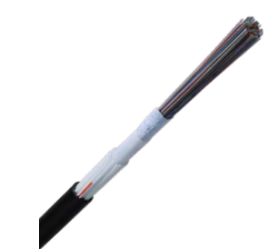
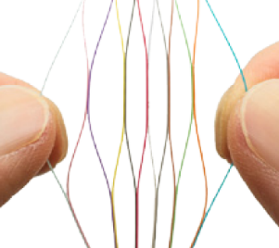
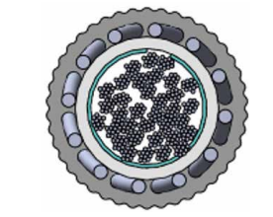
RollR – the first Rollable Ribbon microcable
10mm cable
288 (250 µm) or 432 (200 µm) fibers
Ribbon splicing
Ultra high fiber density
No preferred bending plane
More rugged than some high density loose tube microcables
Designed primarily for blowing
400 lb pull tension

Slide 21
How to specify microcables and microducts
1 – Determine fiber count and cable type
2 – Choose microduct or FuturePath type
3 – Select corresponding part numbers

Slide 22
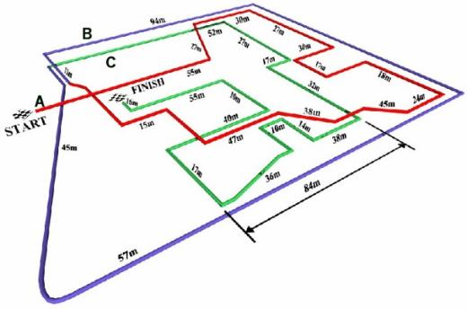
Installation basics
MiDia FX can be pulled
300 lbs pulling tension
GR-20 qualified as “Special Applications” cable
MiDia GX and 2FX should be blown
Typical cable/microduct fill ratios (diameter to diameter) – 65%-75%
Not intended for aerial deployments (without microduct)
Not intended for FTTH distribution applications requiring expressing in pedestals
OFS is happy to discuss requirements with customers
96 fiber MiDia GX Trial
Difficult route
Cable with PA (nylon) sheath
2000 m in approx. 35 minutes
Notes:
First Trials with BT in 1999 –
Original target in 1999-2000 was 1500m in 45mins.
OFS now achieve 2500m in ~ 45 mins. Best blowing performance of our competitors.
influenced their new network build and cable specifications
In addition to the results shown here, OFS successfully completed a 6.5km installation for a customer in Linz in Austria. The cable used was 144f and installation was completed in 3 steps.

Slide 23
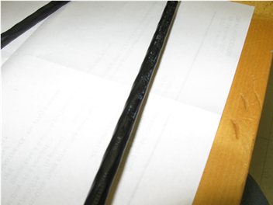
Microcable limitations
GX and 2FX are less robust than traditional cables
Thinner sheaths
Less crush resistance
Lower tensile strength
Not designed for aggressive handling scenarios
Shared hand-holes
Not following minimum bending diameter
Excessive crush forces in hand-holes
Cables are accessed and removed routinely (coiling, re-coiling)
Cables are coiled/stored in undersized handholes

Slide 24
Tools available
Solutions guide
Fiber/duct/microduct size calculator
Installation guidelines
Installation support

Slide 25
Summary
OFS has a range of fibers to support different applications
AllWave+ is an excellent choice for most applications
Bend insensitivity with 9.2 micron MFD
Microcables can enable fiber placement in tight spaces, or higher fiber counts
Increase blowing distances and decrease intermediate points
More cable on a reel
Lower costs and increase deployment speeds
OFS has a wide range of microcables for different applications
MiDia FX is the preferred choice for most scenarios
Higher fiber count cables and smaller size available with MiDia GX, 2FX, 2GX

Slide 26
Outside Plant Cable Etiquette – Dos and Don’ts
Notes:
Mark

Slide 27
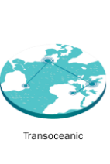
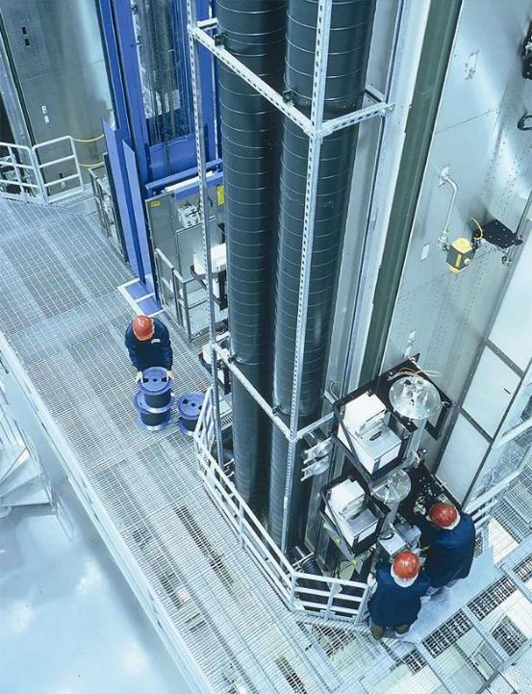
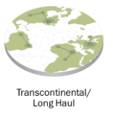
About OFS
© 2020 OFS
Global Manufacturer
Fiber
Cable
Optical Components used in Networks
Splicers
Professional services
Bell Labs Fiber Heritage
Notes:
Mark

Slide 28
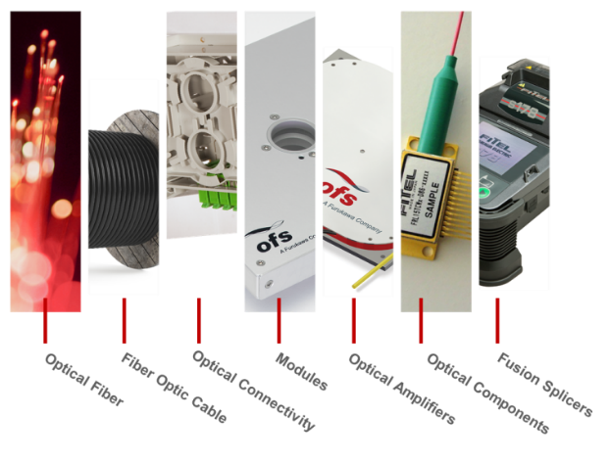
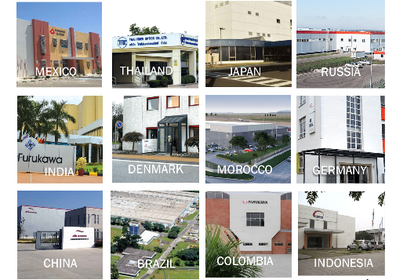
US-Based with Global Reach
© 2020 OFS
Notes:
Mark

Slide 29
01
Know your cable
Introduction to Cable Structures and limitations
Cable etiquette
Blowing
Pulling
Aerial installations
Our Agenda
Outside Plant Cable Etiquette – Dos and Don’ts
02
Notes:
Mark

Slide 30
The fiber is the network™ The cable protects it
Notes:
Mark

Slide 31
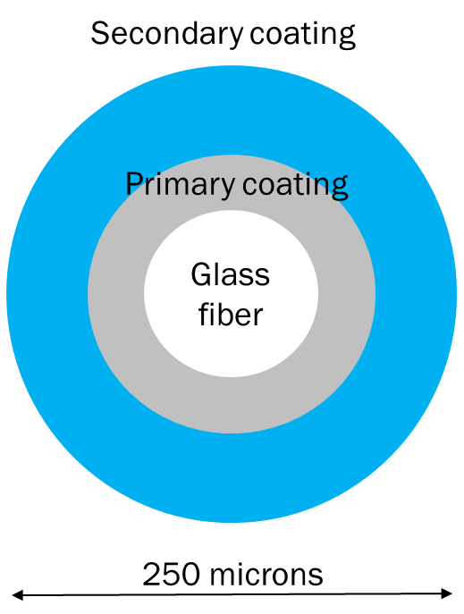
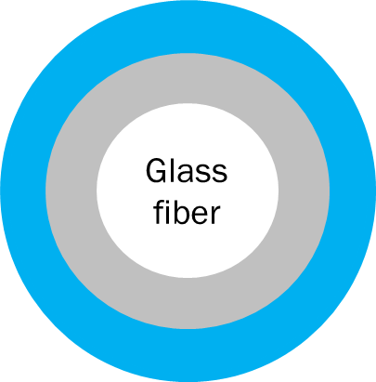
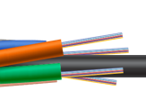
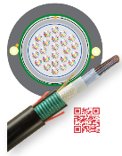
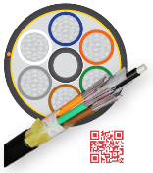
New Fiber Sizes and Structures
© 2020 OFS
Fiber Sizes
200 microns
Fiber Structures
Loose Tube and Micro
Flat Ribbon
Rollable Ribbon
Cable Structures
Central Tube
Stranded
Notes:
Mark

Slide 32
Fiber and Cable Standards
Standards are a starting point
Compliance doesn’t ensure success
Common fiber standards
Telcordia®GR-20
ITU Fiber Recommendations
G.652, G.654, G.657 most common today
Some G.655
Common cable standards
ANSI/ICEA S-87-640-2006
Telcordia®GR-20
IEEE®1222 for ADSS
Some high fiber density cables are less standardized
Microcables and rollable ribbon cables
Notes:
Mark

Slide 33
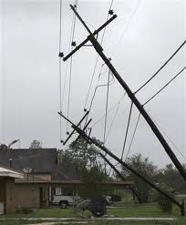
Cable limitations
Tension
Notes:
Mark

Slide 34
Fiber strength
Diameter to diameter, glass is stronger than steel!
When designed and installed properly, fiber can last for decades
Coating performance is an integral part of fiber strength performance
Glass strength can be limited by flaws
Fiber strain limited to <0.2% long term, <0.6% short term
600-800 kpsi strength!
34
Notes:
Mark

Slide 35
How pure is OFS glass?
Raw material impurities measured in parts per billion
Roughly 3x more likely to win Powerball than find impurities in the fiber core
Notes:
Mark

Slide 36
Cable etiquette for Tension
Notes:
Howard

Slide 37
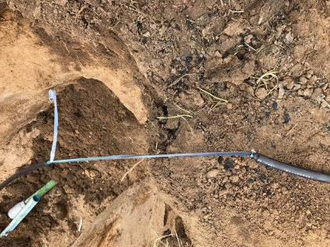
Cable etiquette for Tension
Don’t pull cable with a backhoe, truck, or other powered equipment
Add picture of broken cable
Notes:
Howard

Slide 38
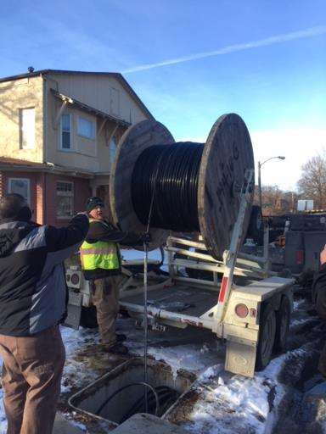
Cable etiquette for Tension – dos and don’ts
Don’t wind under tension using a powered take-up reel
No tension limitation
Fiber subjected to high tensile load for long period of time
Macrobending can occur from resulting poor level wind
Notes:
Howard

Slide 39
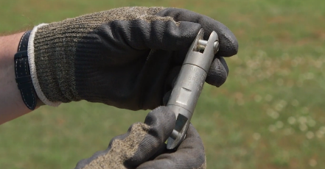
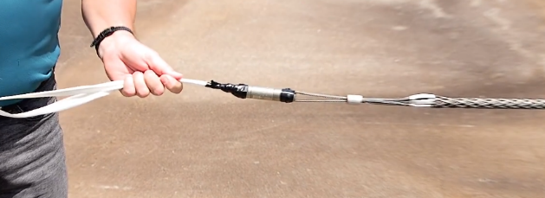
Cable etiquette for Tension – dos and don’ts
For duct installations, do use a breakaway swivel to connect the rope to the cable
For aerial installations, don’t use breakaway swivels unless accompanied by a safety sling
Notes:
Howard

Slide 40
Cable etiquette for Tension
Diameter ratio is the ratio of cable outer diameter to duct inner diameter
For most installations, keep diameter ratios to <75% to reduce cable pulling tension
Notes:
Howard

Slide 41
Cable limitations
Bending
Notes:
Mark

Slide 42
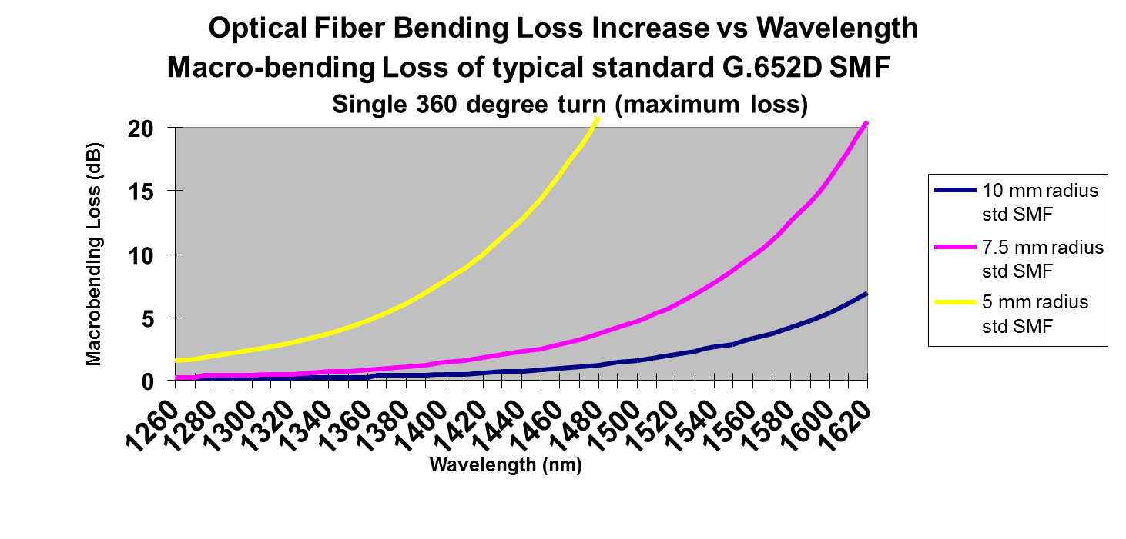
Fiber bending properties
Notes:
Mark

Slide 43
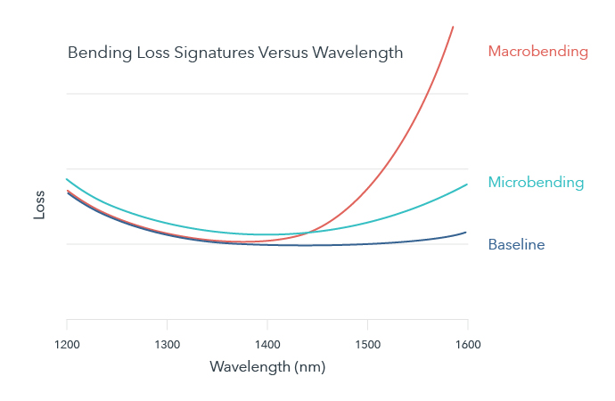
Microbending and macrobending
Notes:
Mark

Slide 44
Outside Plant Cable Etiquette - Bending
Minimum bend radius is usually specified as a multiple of cable diameter
Notes:
Howard

Slide 45
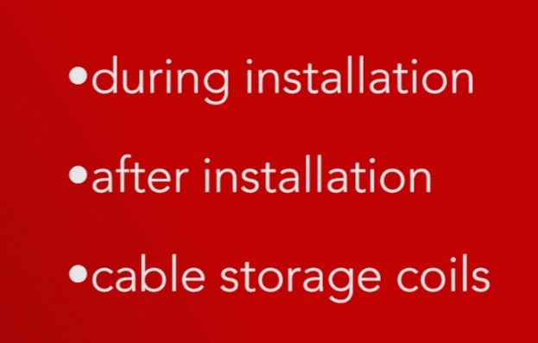
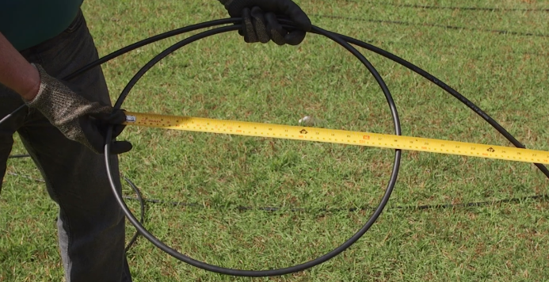
Outside Plant Cable Etiquette - Bending
Minimum bend radius is specified for different applications
Different values for different cable designs
Notes:
Howard

Slide 46
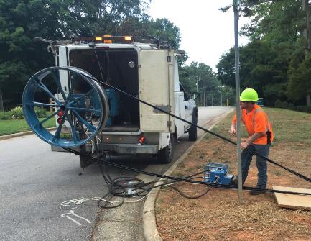
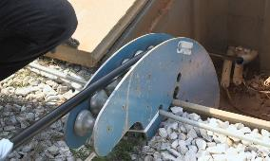
Outside Plant Cable Etiquette
Bend diameter is controlled by
Using correct diameter capstans
Using correct diameter sheaves and quadrant blocks (if permitted)
Forming cable storage loops in correct diameter
Not controlling the bend diameter may result in the fibers being crushed during the installation process
Notes:
Howard

Slide 47
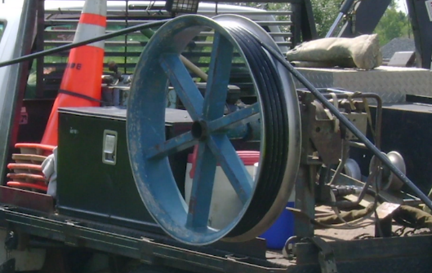
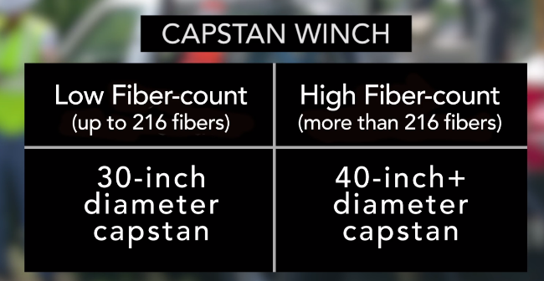
Outside Plant Cable Etiquette - Bending
Capstan winch recommendations
Notes:
Howard

Slide 48
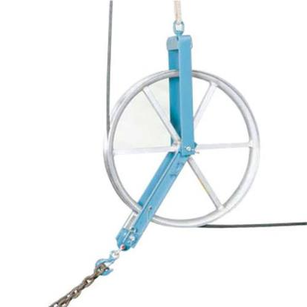
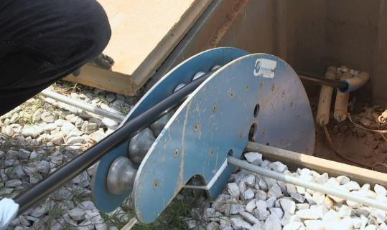
Outside Plant Cable Etiquette - Bending
Do use fiber optic cable sheaves to guide cables in and out of manholes and handholes
Photo courtesy of Condux
Notes:
Howard

Slide 49
Outside Plant Cable Etiquette - Bending
Do use quadrant blocks only with central core cables
Only use fiber optic quadrant blocks
Notes:
Howard

Slide 50
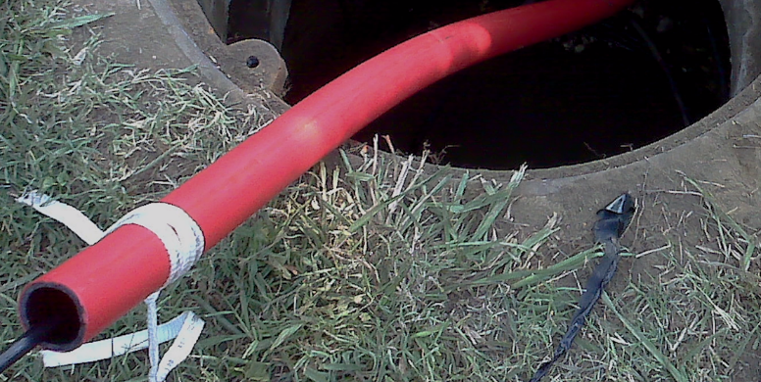
Outside Plant Cable Etiquette - Bending
Thick walled innerduct can be used as a feed tube into manholes or handholes
Notes:
Howard

Slide 51
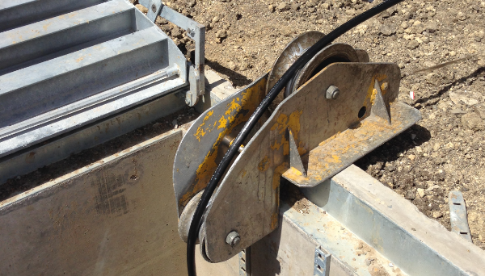
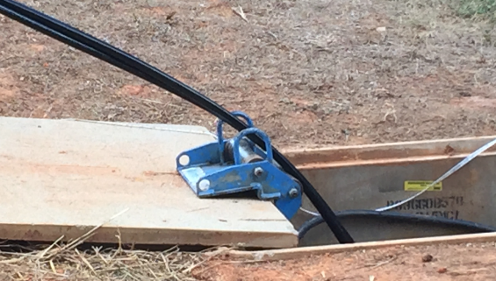
Outside Plant Cable Etiquette - Bending
Rollers need to be large enough to support minimum bend diameters
Notes:
Howard

Slide 52
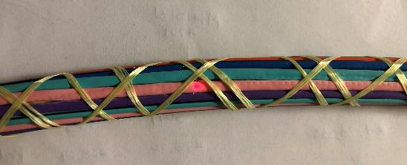
Outside Plant Cable Etiquette - Bending
Notes:
Howard

Slide 53
Storage coils dos and don’ts
Do observe storage coil radius and diameter recommendations
Cable and fiber damage can occur if storage coil recommendations are not followed
Don’t make the coils too small
Notes:
Howard

Slide 54
Outside Plant Cable Etiquette – Storage coils
Fold over method
Notes:
Howard

Slide 55
Outside Plant Cable Etiquette – Storage coils
Teardrop method

Slide 56
Outside Plant Cable Etiquette – Storage coils
Garden Hose method
Notes:
Howard

Slide 57
Figure 8 dos and don’ts
Do spread out figure-8 crossover points
Notes:
Howard

Slide 58
Figure 8 dos and don’ts
Notes:
Howard

Slide 59
Figure 8 dos and don’ts
Don’t build figure 8 stacks that place crossover points on top of each other
Notes:
Howard

Slide 60
Cable Blowing
Preferred installation method
Low stress environment for the cable
Long, continuous installation lengths possible
Notes:
Howard

Slide 61
Cable blowing dos and don’ts
Do follow equipment manufacturer recommendations for pressures
Slip and buckling tests
Notes:
Howard

Slide 62
Cable blowing dos and don’ts
Don’t use improper pressure
Jacket abrasion or cable buckling can occur with improper pressures
Notes:
Howard

Slide 63
Cable blowing dos and don’ts
Notes:
Howard

Slide 64
Cable blowing dos and don’ts
Do observe proper fill ratio
Optimal blowing diameter fill ratio between 50-75%
Microcable fill ratios may be slightly different
Notes:
Howard

Slide 65
Aerial Network Etiquette
Cable lashed to a messenger
All-Dielectric, Self-Supporting (ADSS) cable
Notes:
Mark

Slide 66
Aerial Lashed Networks - cable etiquette
Cables lashed to messengers have span length limits correlating to NESC loading district
Limits are needed to a) reduce fiber strain under storm load, and b) limit tension of suspension strand
Adding additional cables to a messenger decreases recommended span length
Consult manufacturers for specific recommendations
Notes:
Mark

Slide 67
ADSS installation – proper ADSS etiquette
ADSS cables have different tensile properties than standard lashed or underground cables
Typically higher applied loads
Do consult manufacturer for stringing, sag, and tension information
Do use a dynamometer or other tension measuring method to measure stringing tension
Notes:
Mark

Slide 68
ADSS installations – crushing dos and don’ts
Cable crushing is the largest cause of ADSS installation damage
Stringing block size is critical for ADSS installations
Do follow manufacturer recommendations for stringing blocks
Notes:
Mark

Slide 69
ADSS installations – twisting dos and don’ts
Do use pulling swivels to reduce twisting during ADSS installations (not breakaway swivels)
Do avoid excessive twisting by tying stringing blocks at the appropriate angle
Do monitor twisting with a flag, and keep aware of print string corkscrew
Notes:
Mark

Slide 70
01
Know your cable – appropriate standards and tensile, bending, compressive properties
Avoid excessive bending, twisting, crushing
Different tips for pulled, blown, and aerial installation
When in doubt, seek out guidance!
In Summary
Outside Plant Cable Etiquette – Dos and Don’ts
02
03
04
Notes:
Mark

Slide 71
For More Information
Brian Maxwell
bmaxwell@ofsoptics.com
Notes:
Mark

